Slide 1
Altitude-dependencies and driving processes of daily streamflow trends in the central Norwegian mountains
Amalie Skålevåg

Slide 2
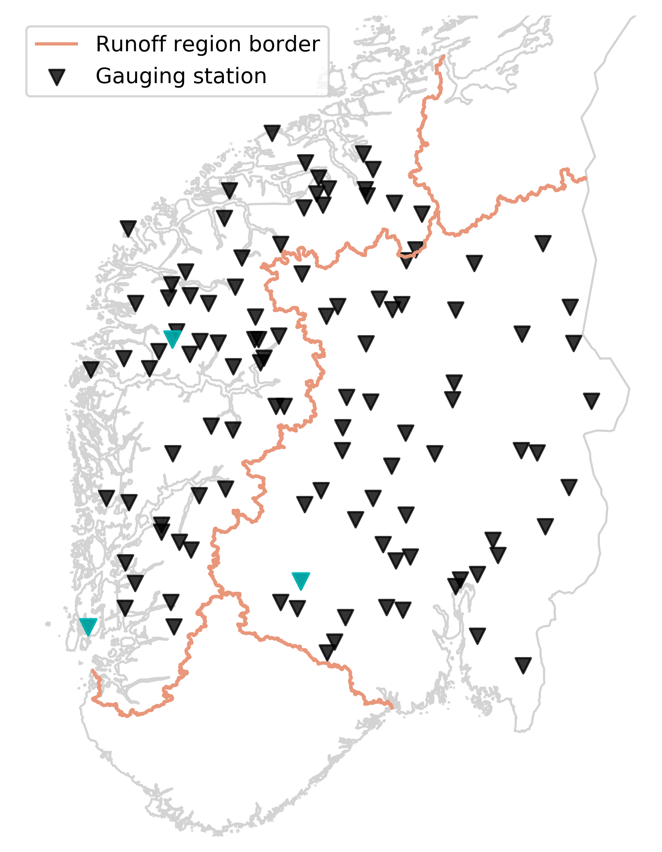
Catchments
112 catchments total
  61 Vestlandet
  51 Østlandet

Slide 3
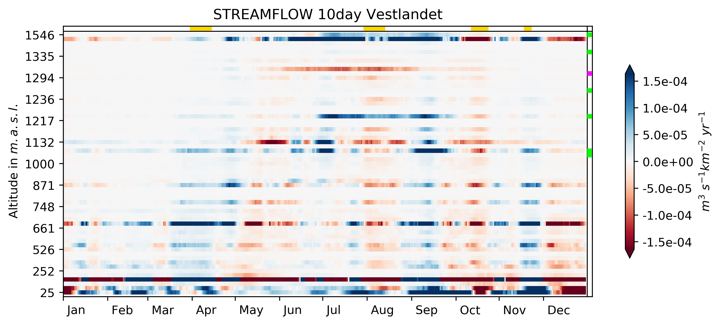
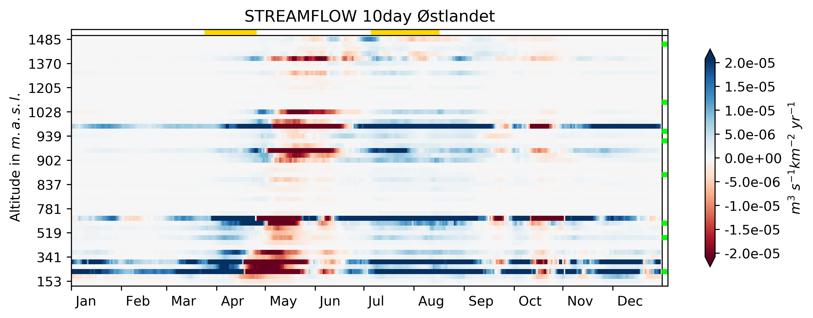
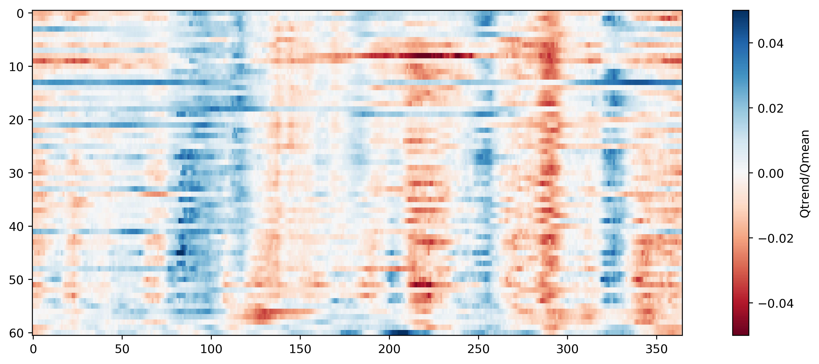
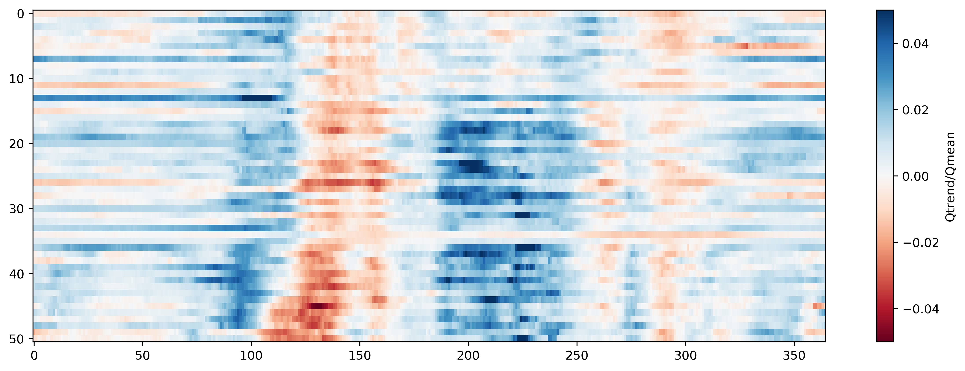
Streamflow trend

Slide 4
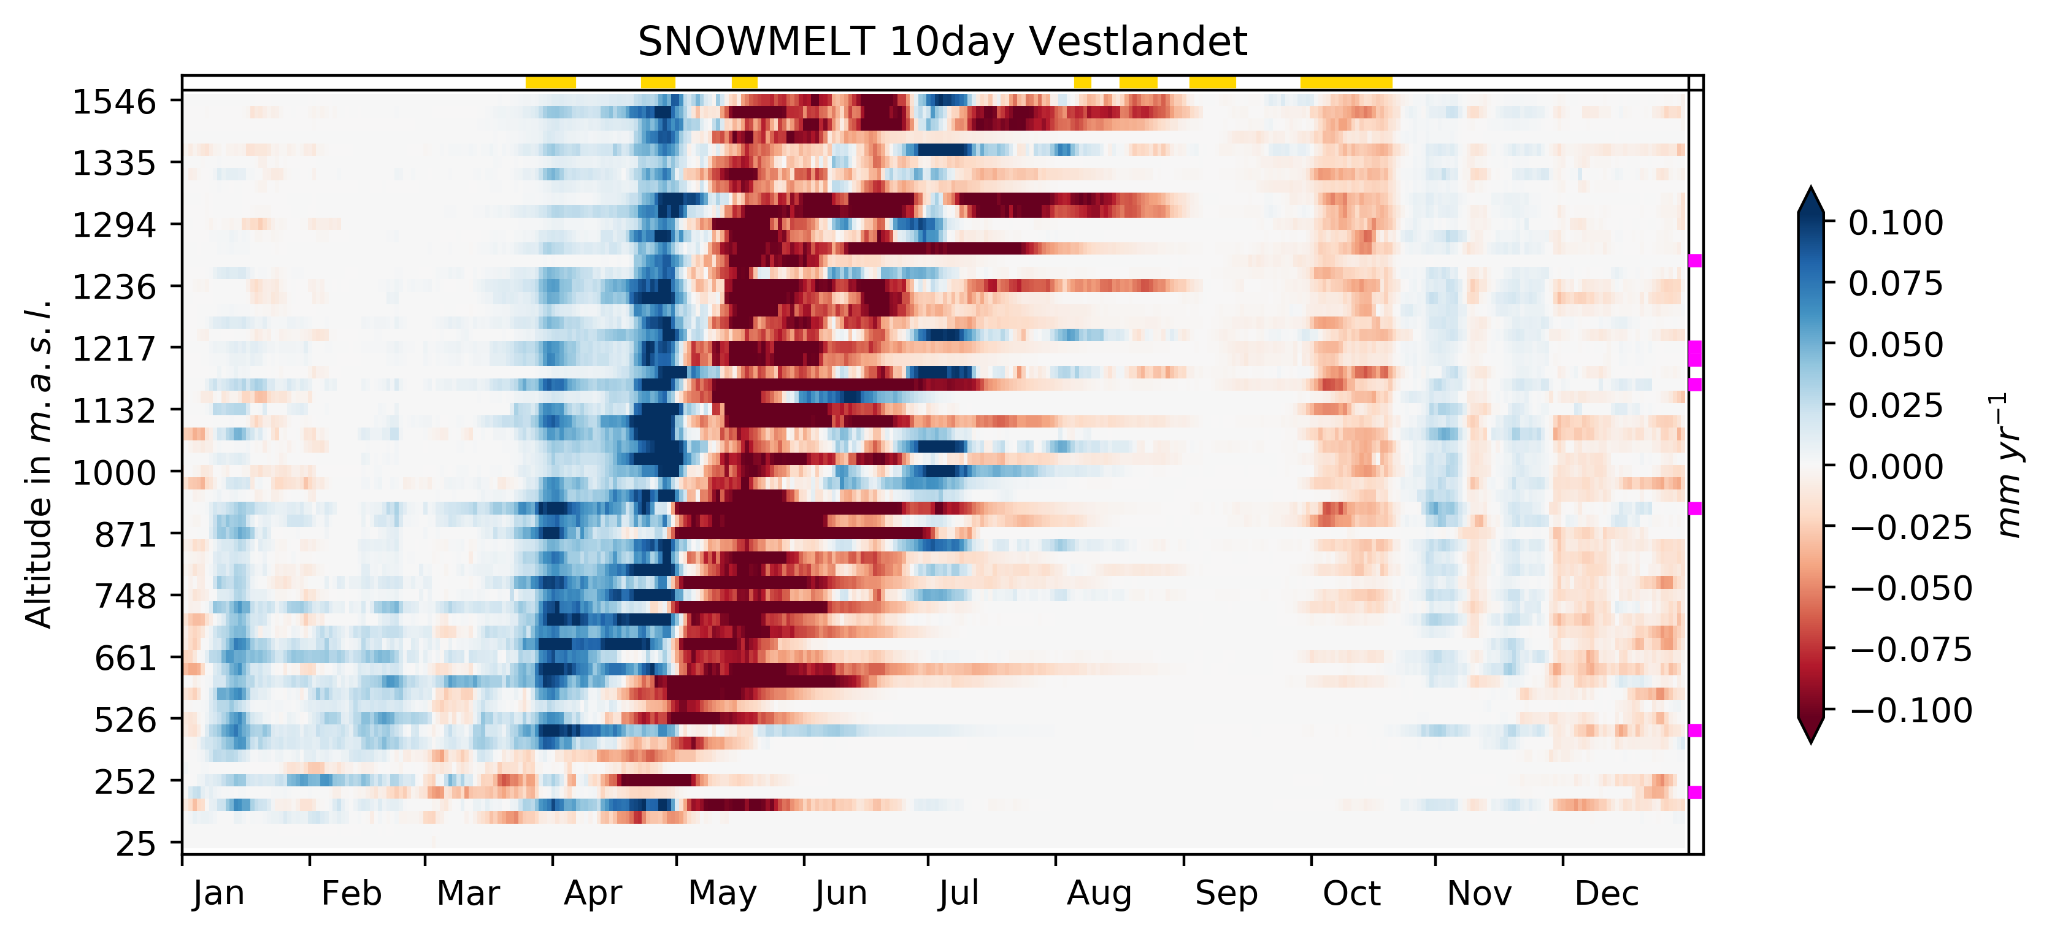
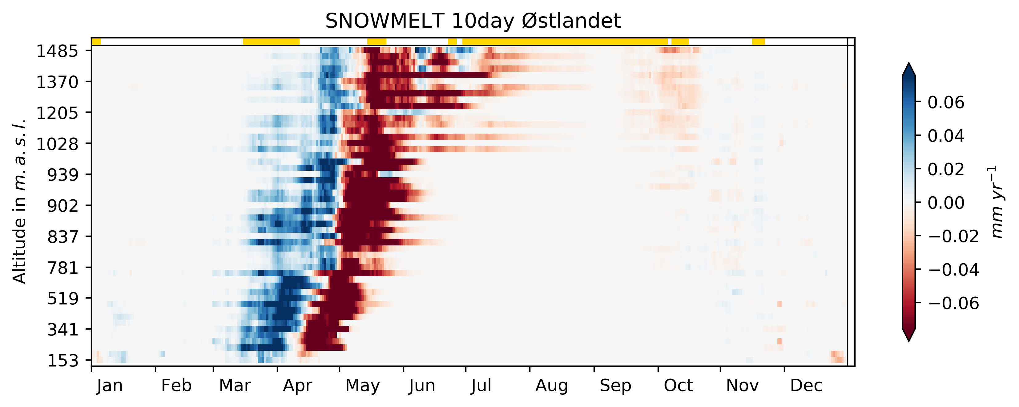
Snowmelt trend

Slide 5
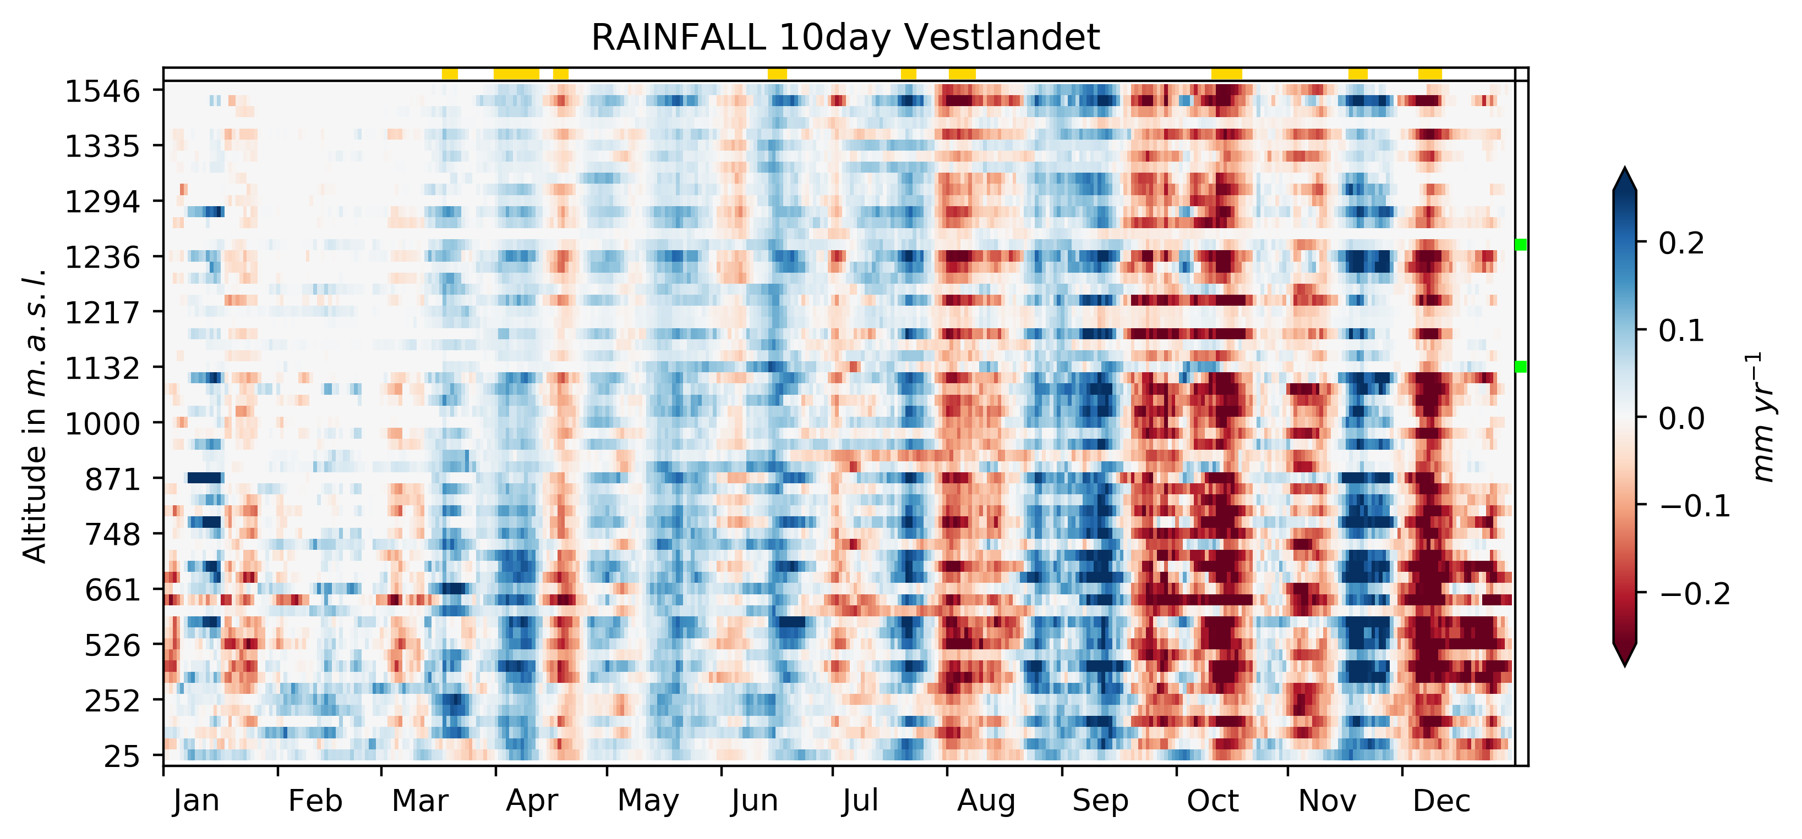
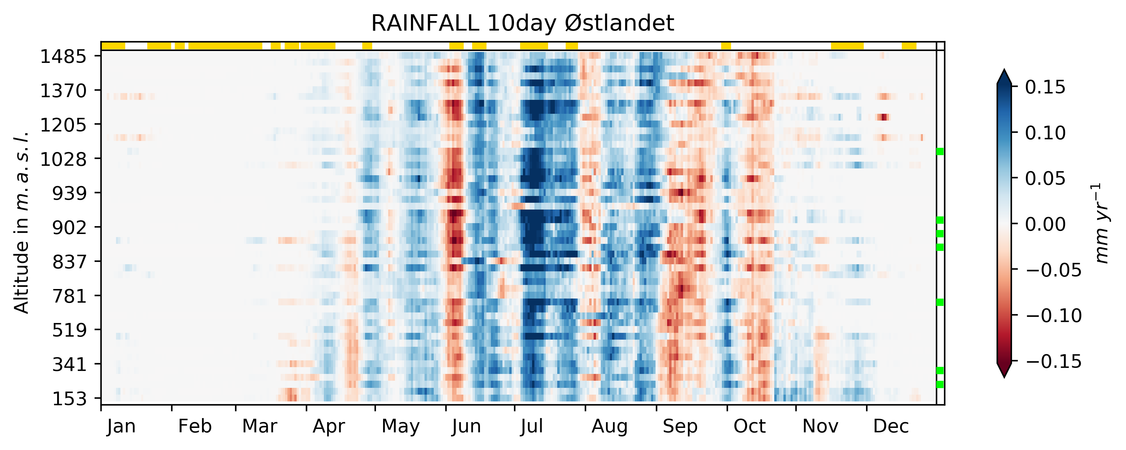
Rainfall trend

Slide 6
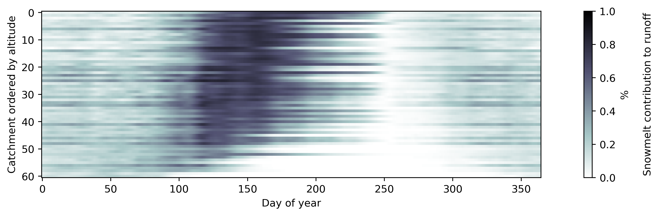
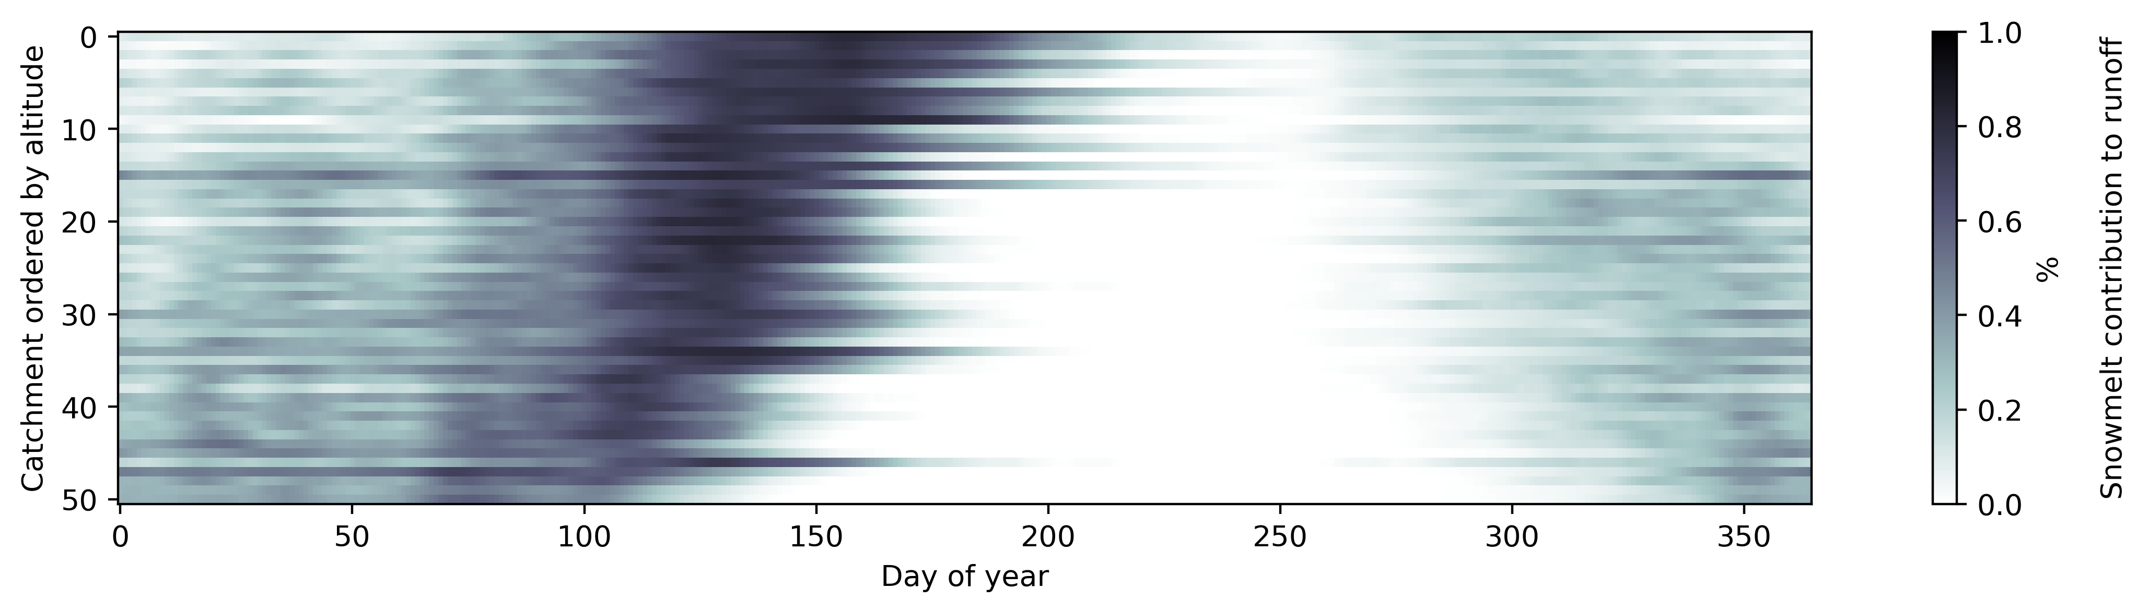
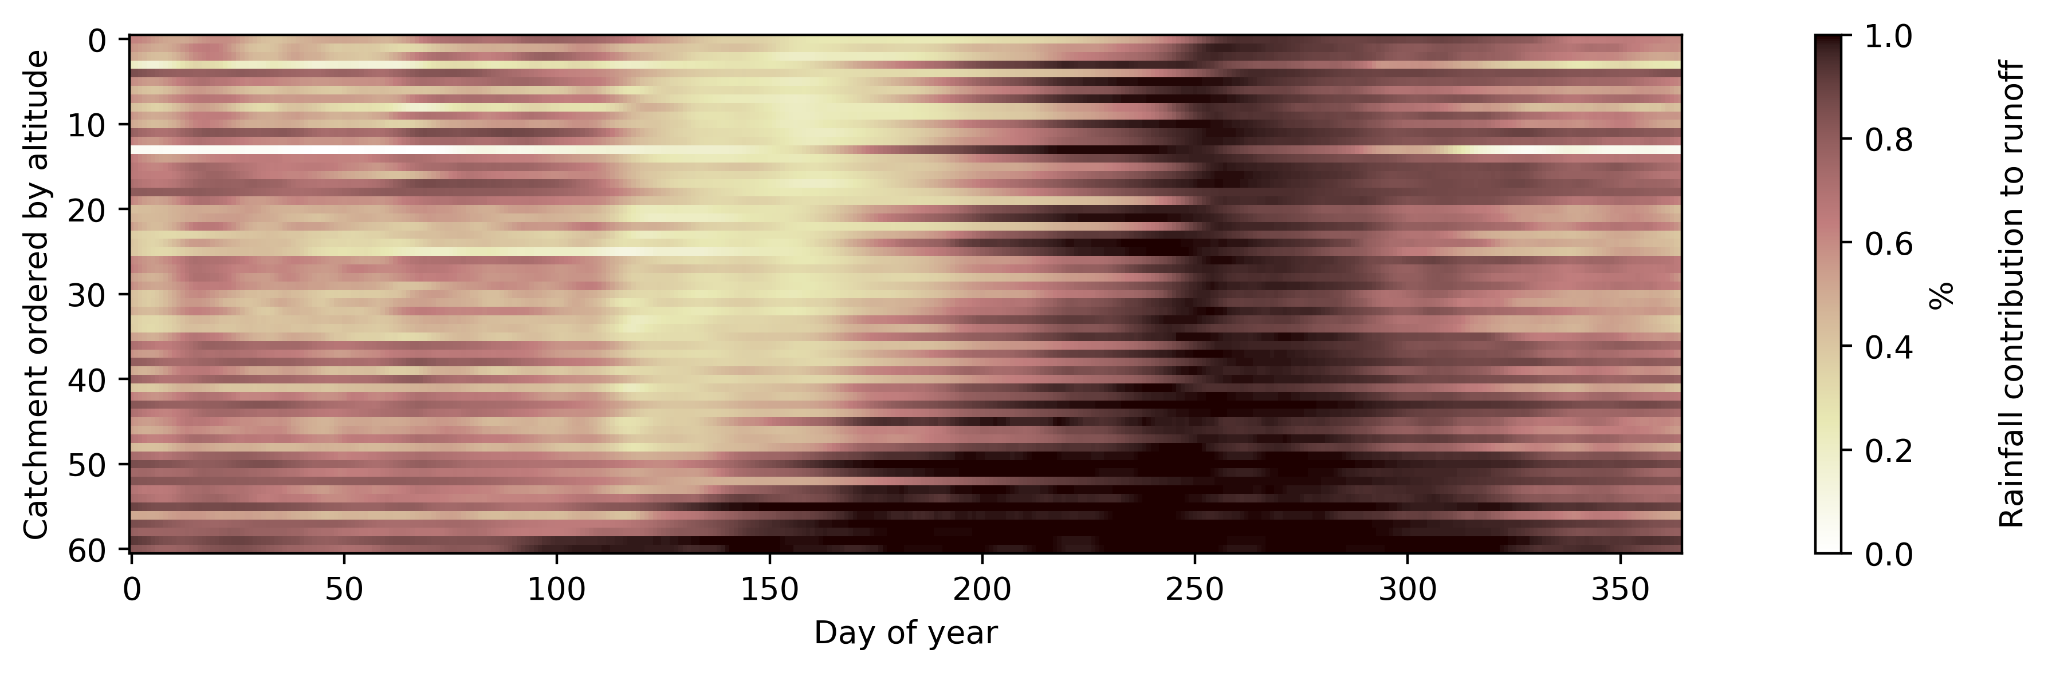
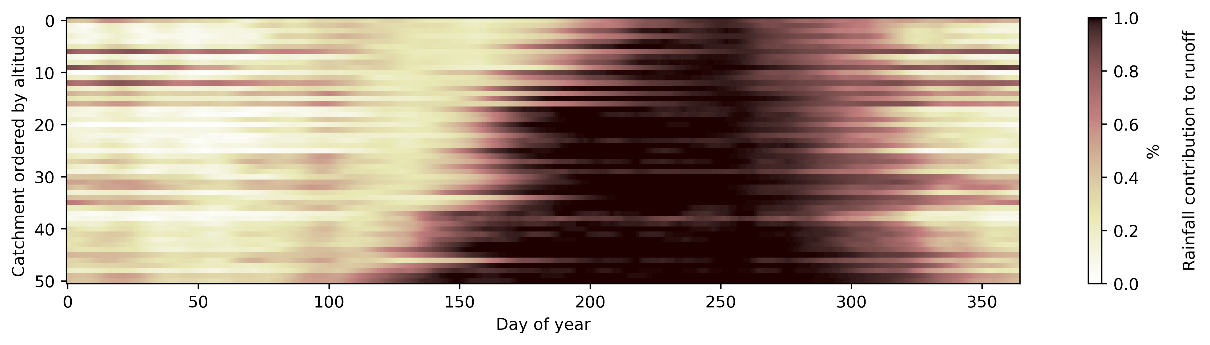
Contributing proportion means
Vestlandet
Østlandet

Slide 7
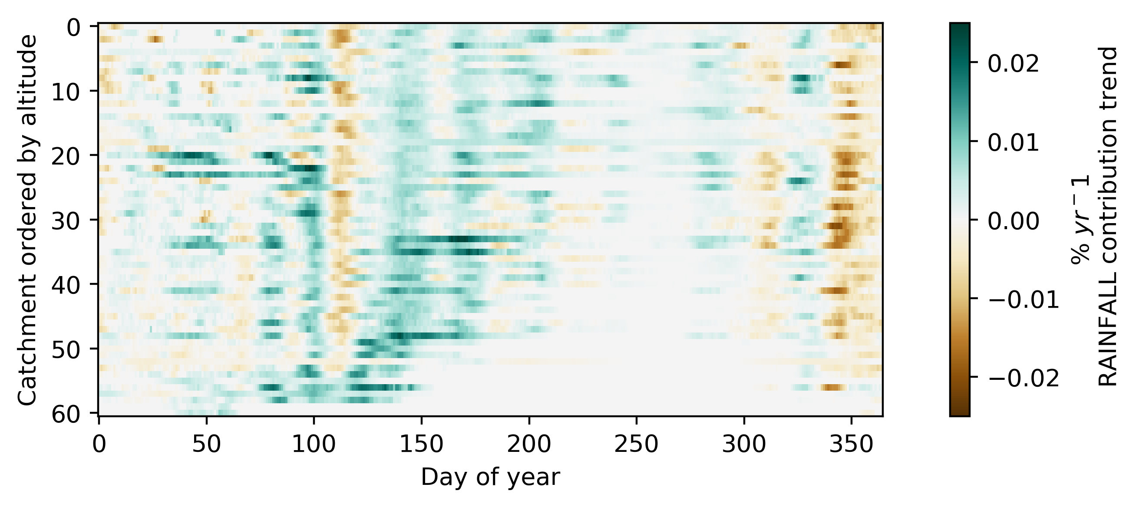
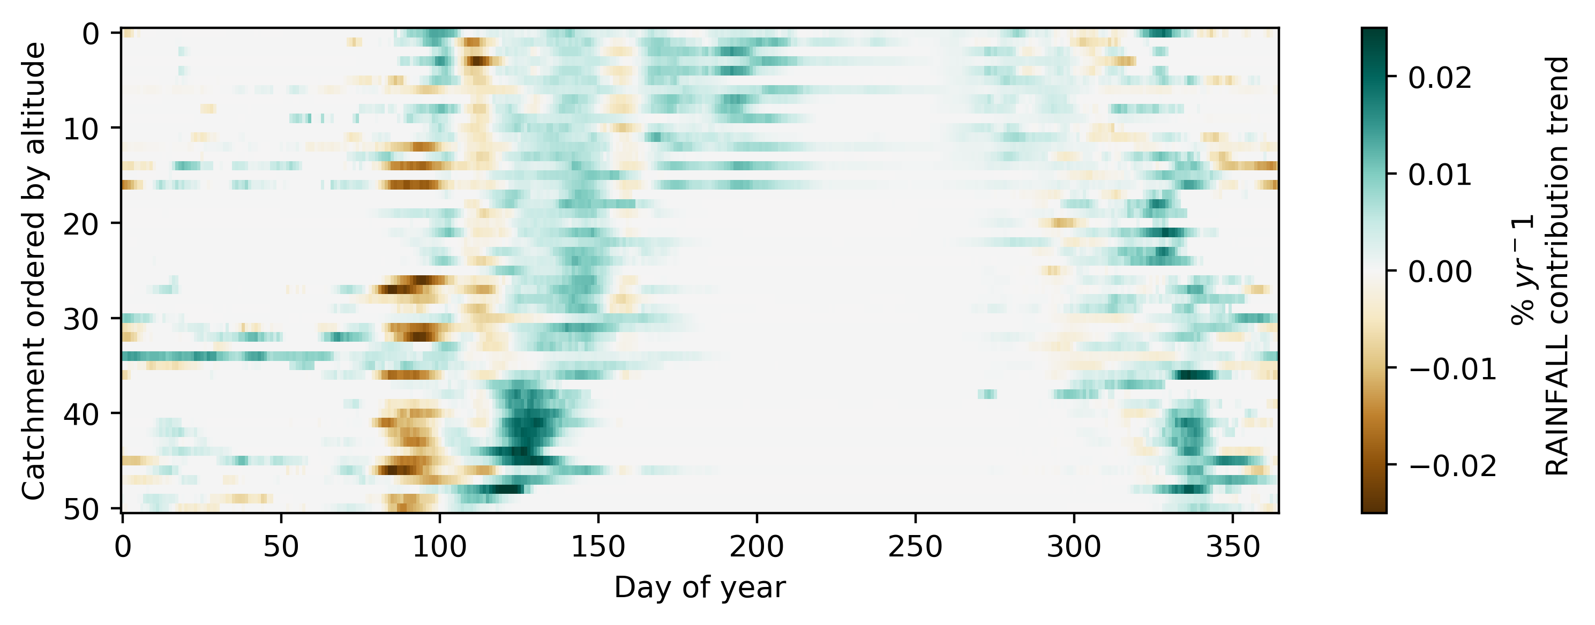
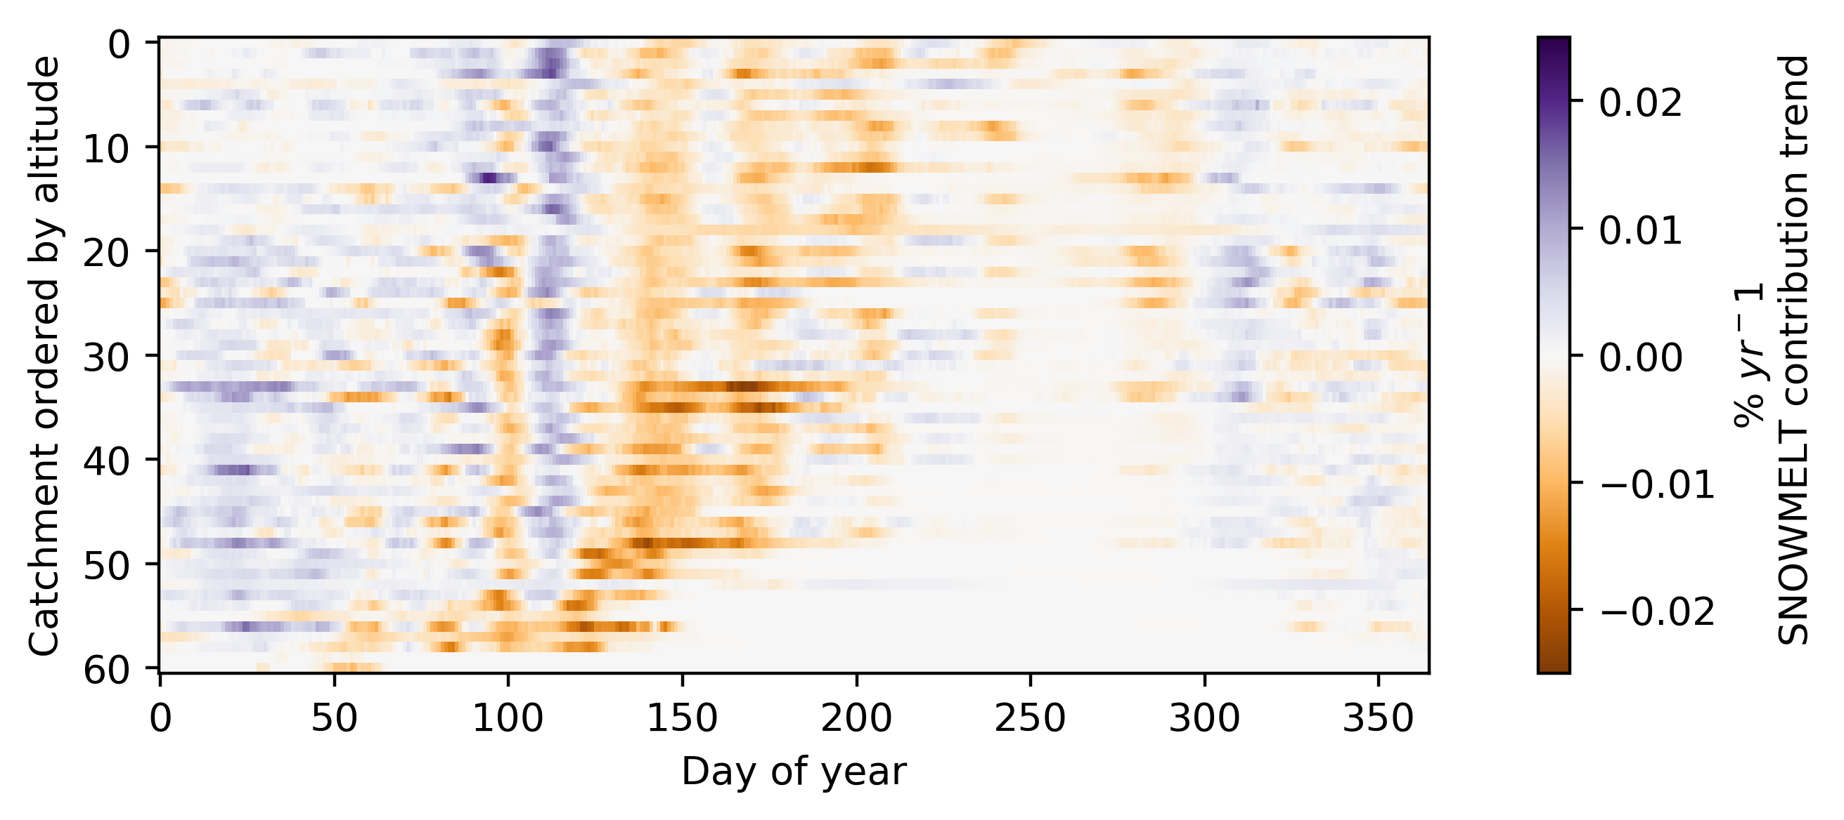
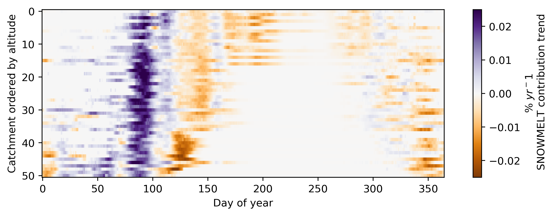
Contributing proportion trends
Vestlandet
Østlandet

Slide 8
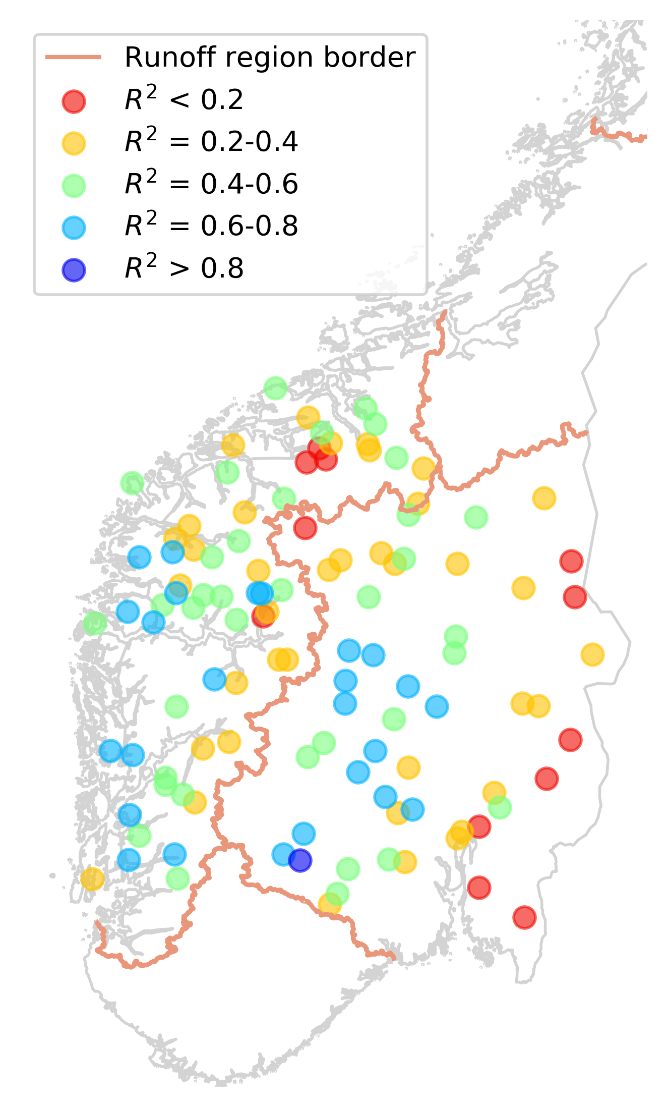
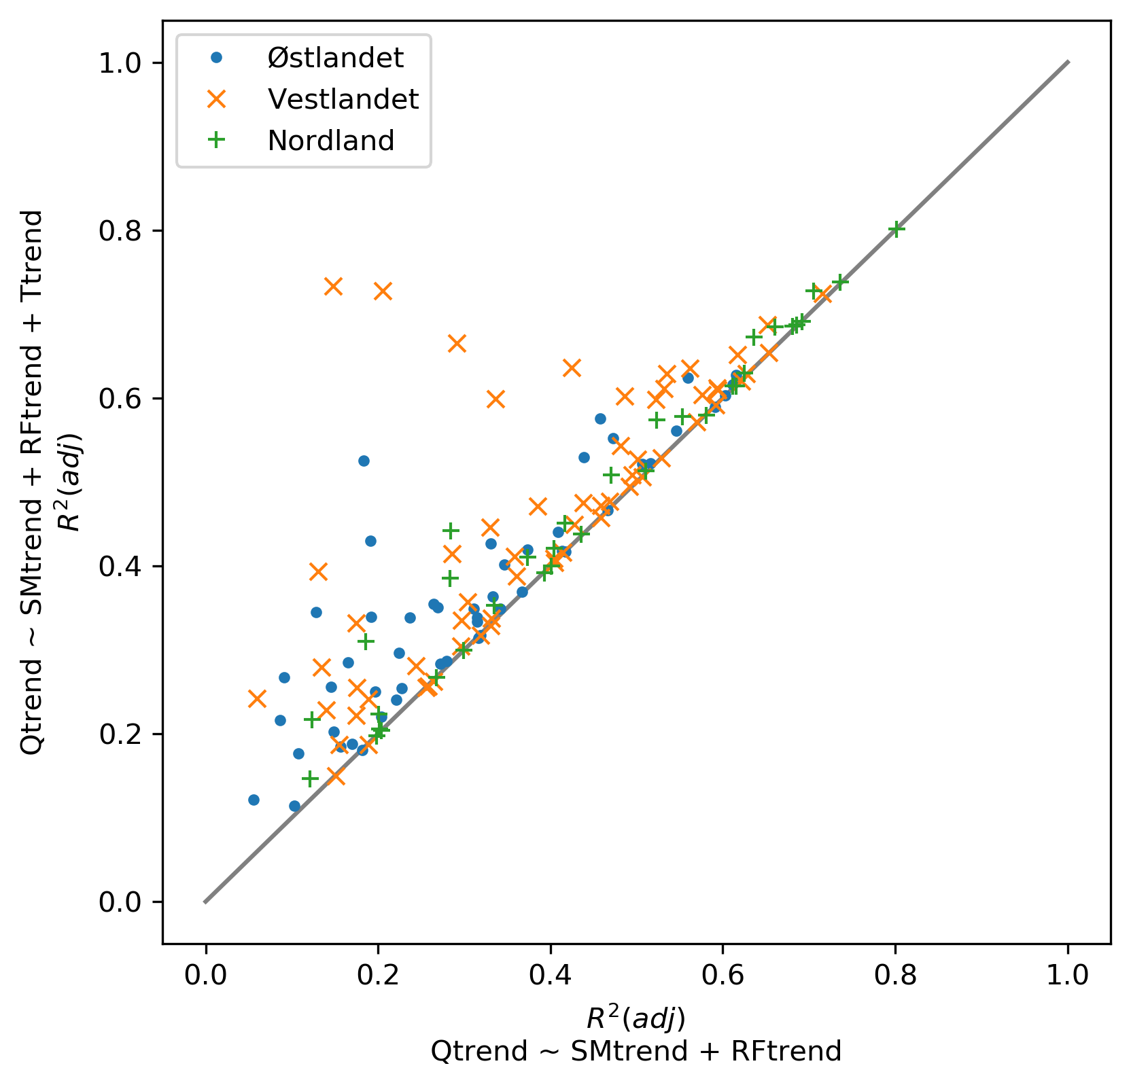
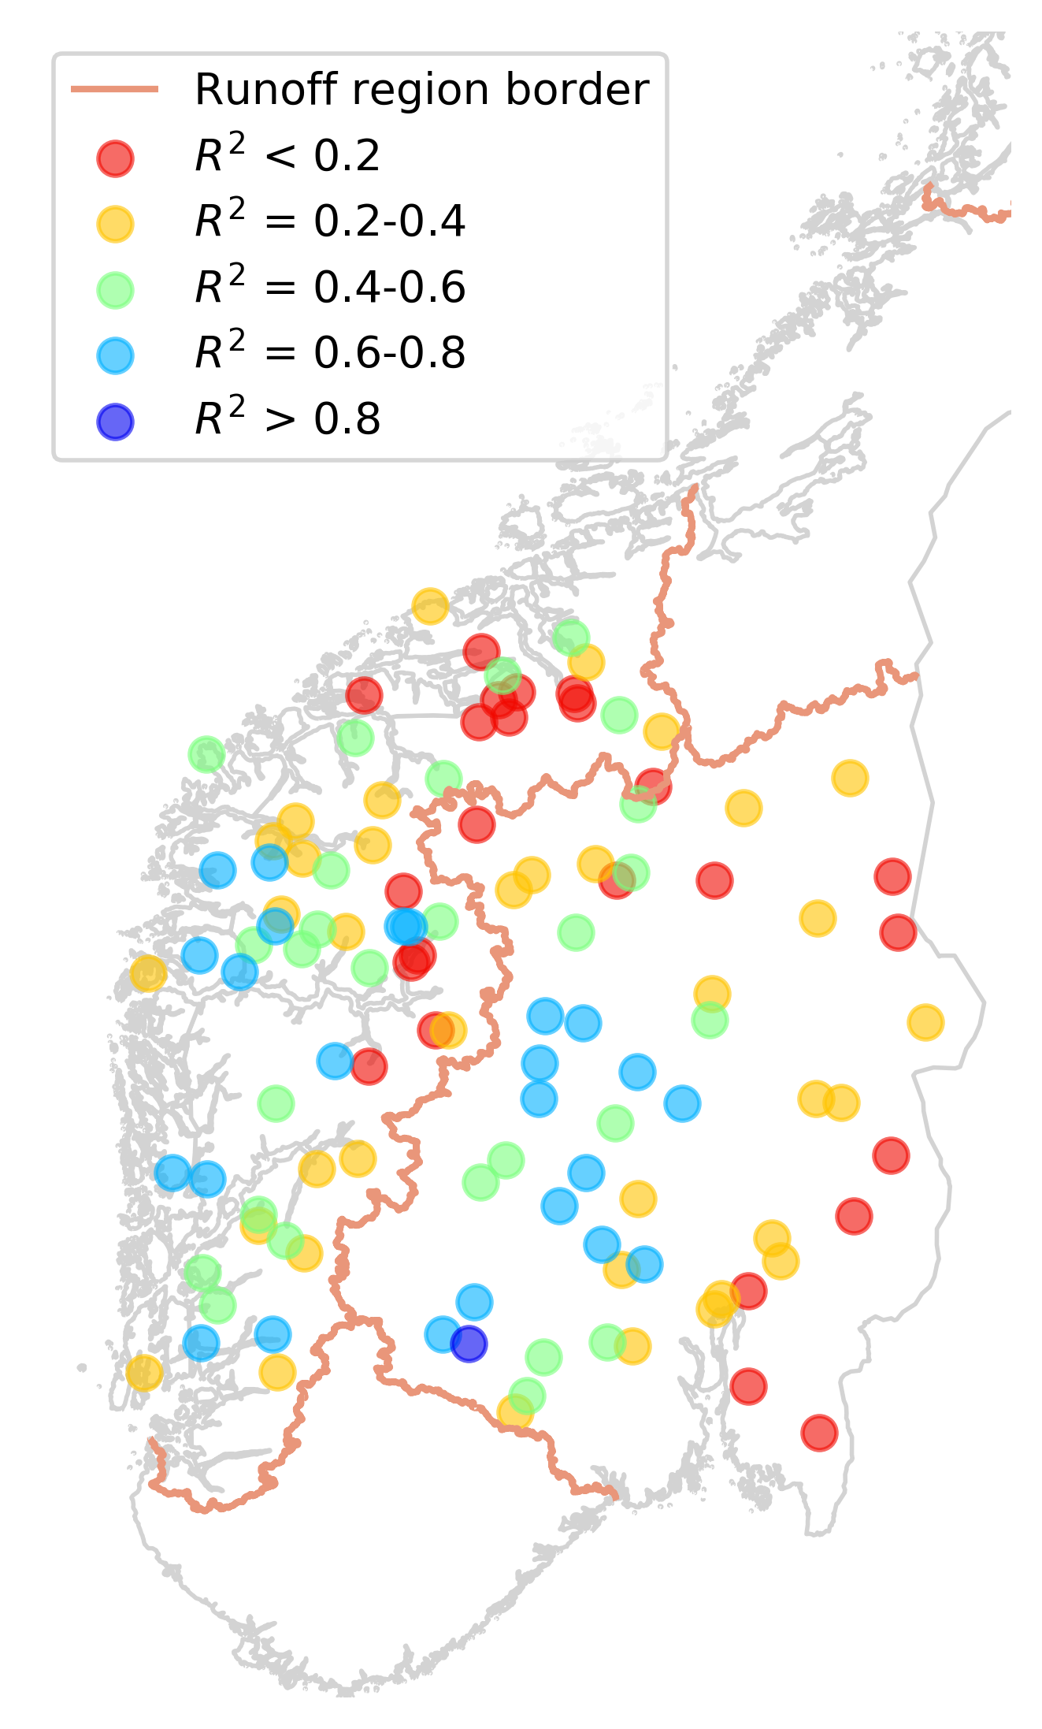
Multiple regression
Adding contributing proportion trend, barely impacts the R-squared.
Qtrend ~ SMtrend + RFtrend
Qtrend ~ SMtrend + RFtrend + Ttrend

Slide 9
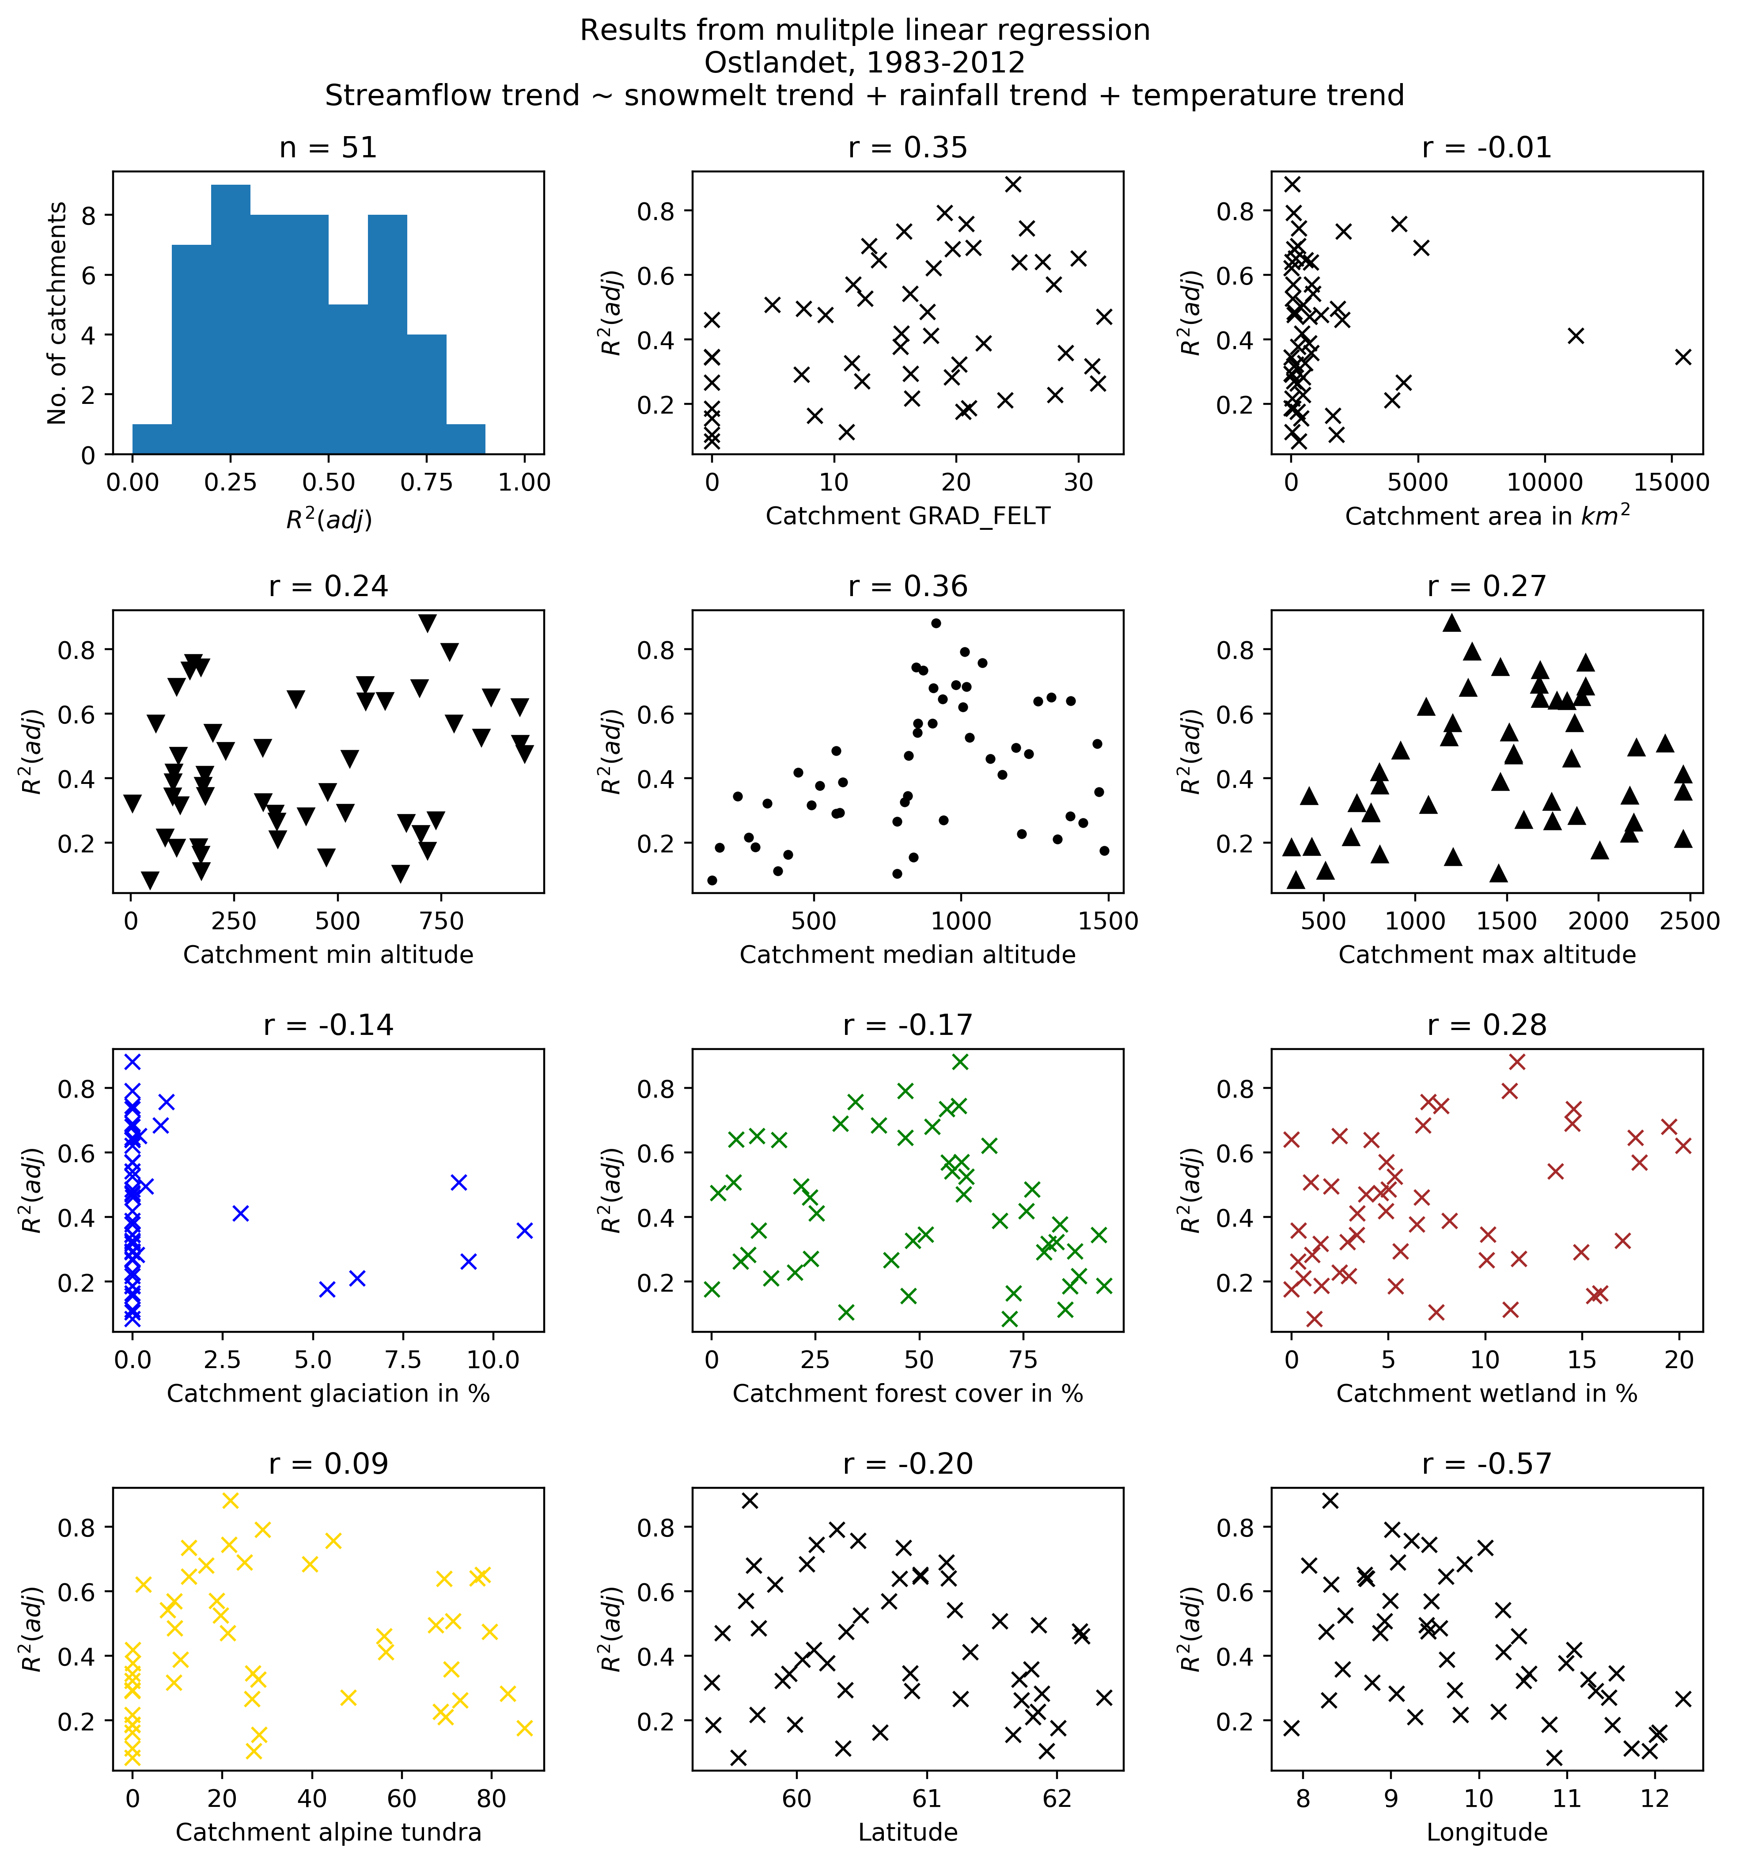
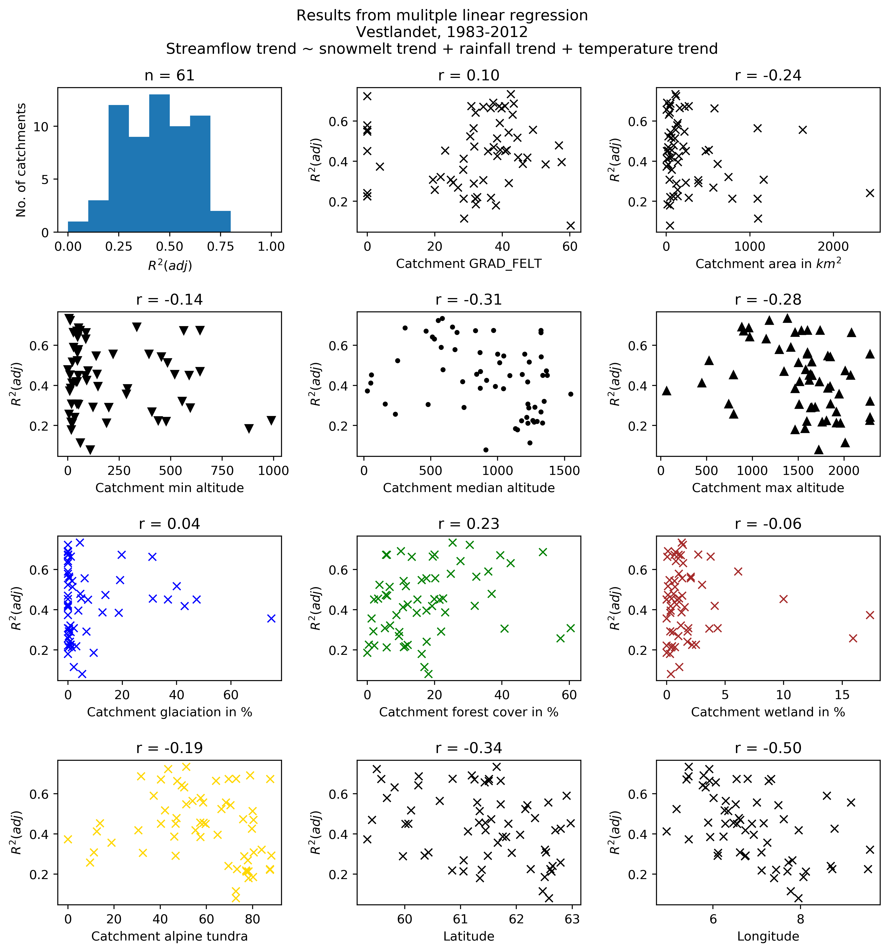
Multiple regression results and catchment parameters

Slide 10
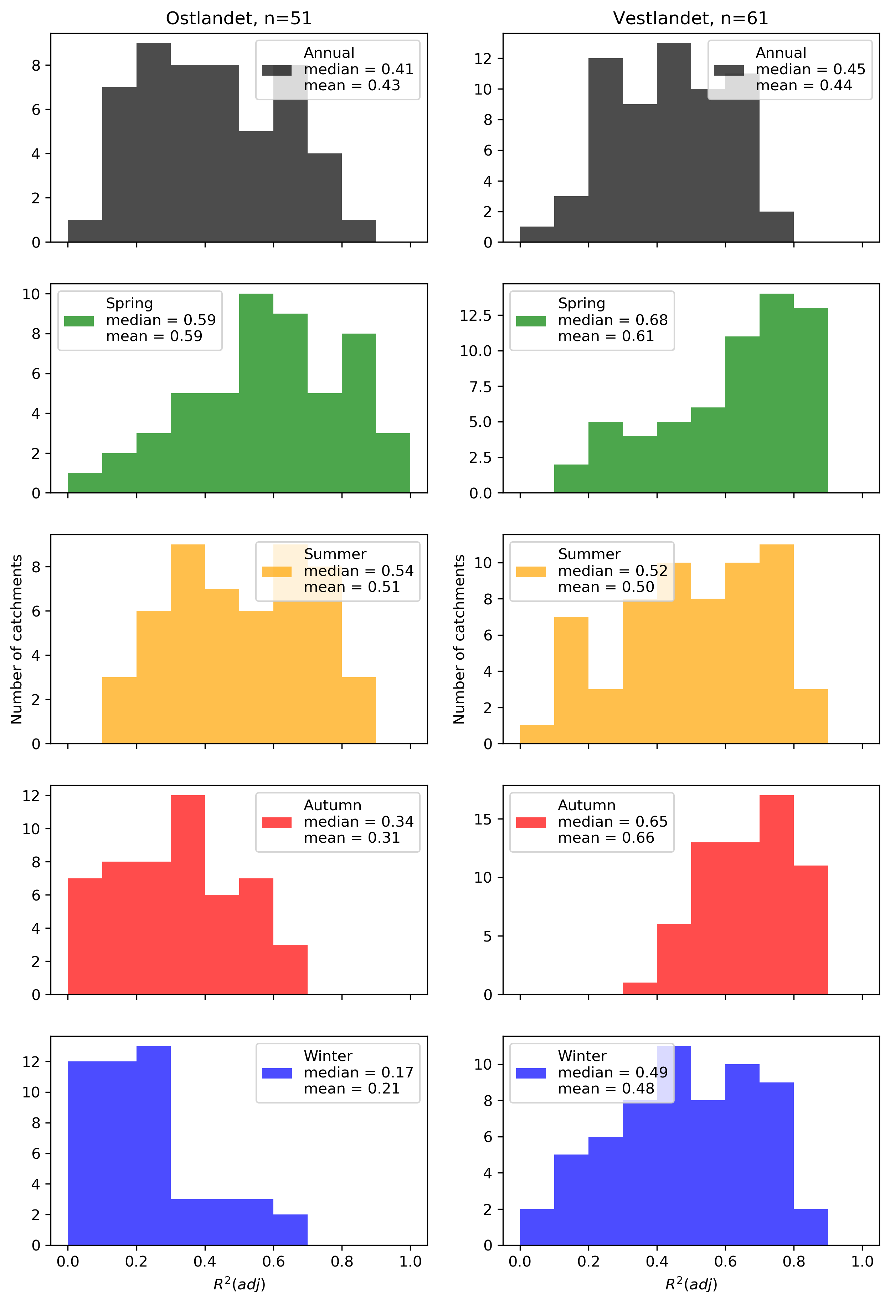
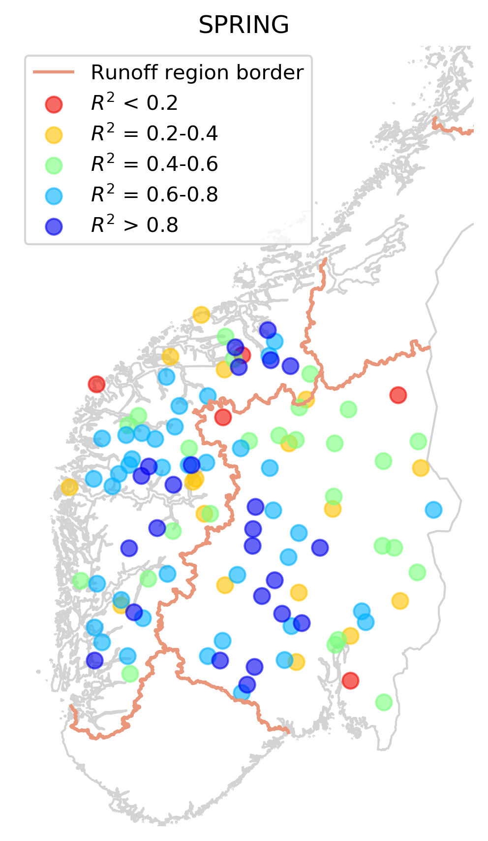
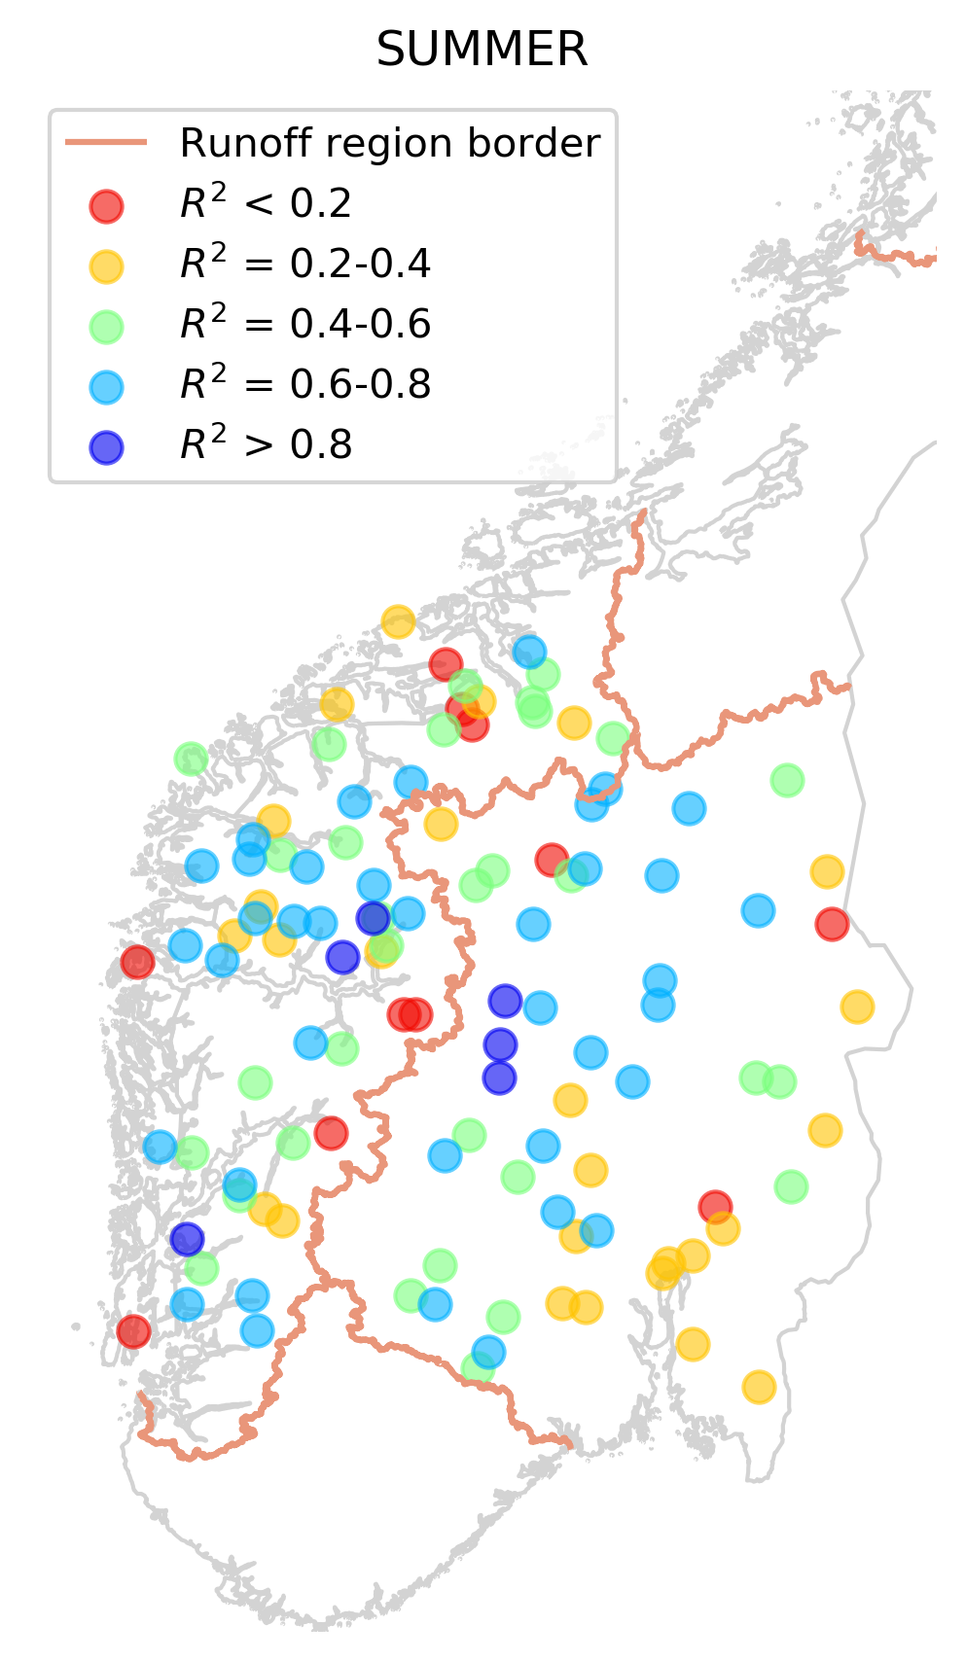
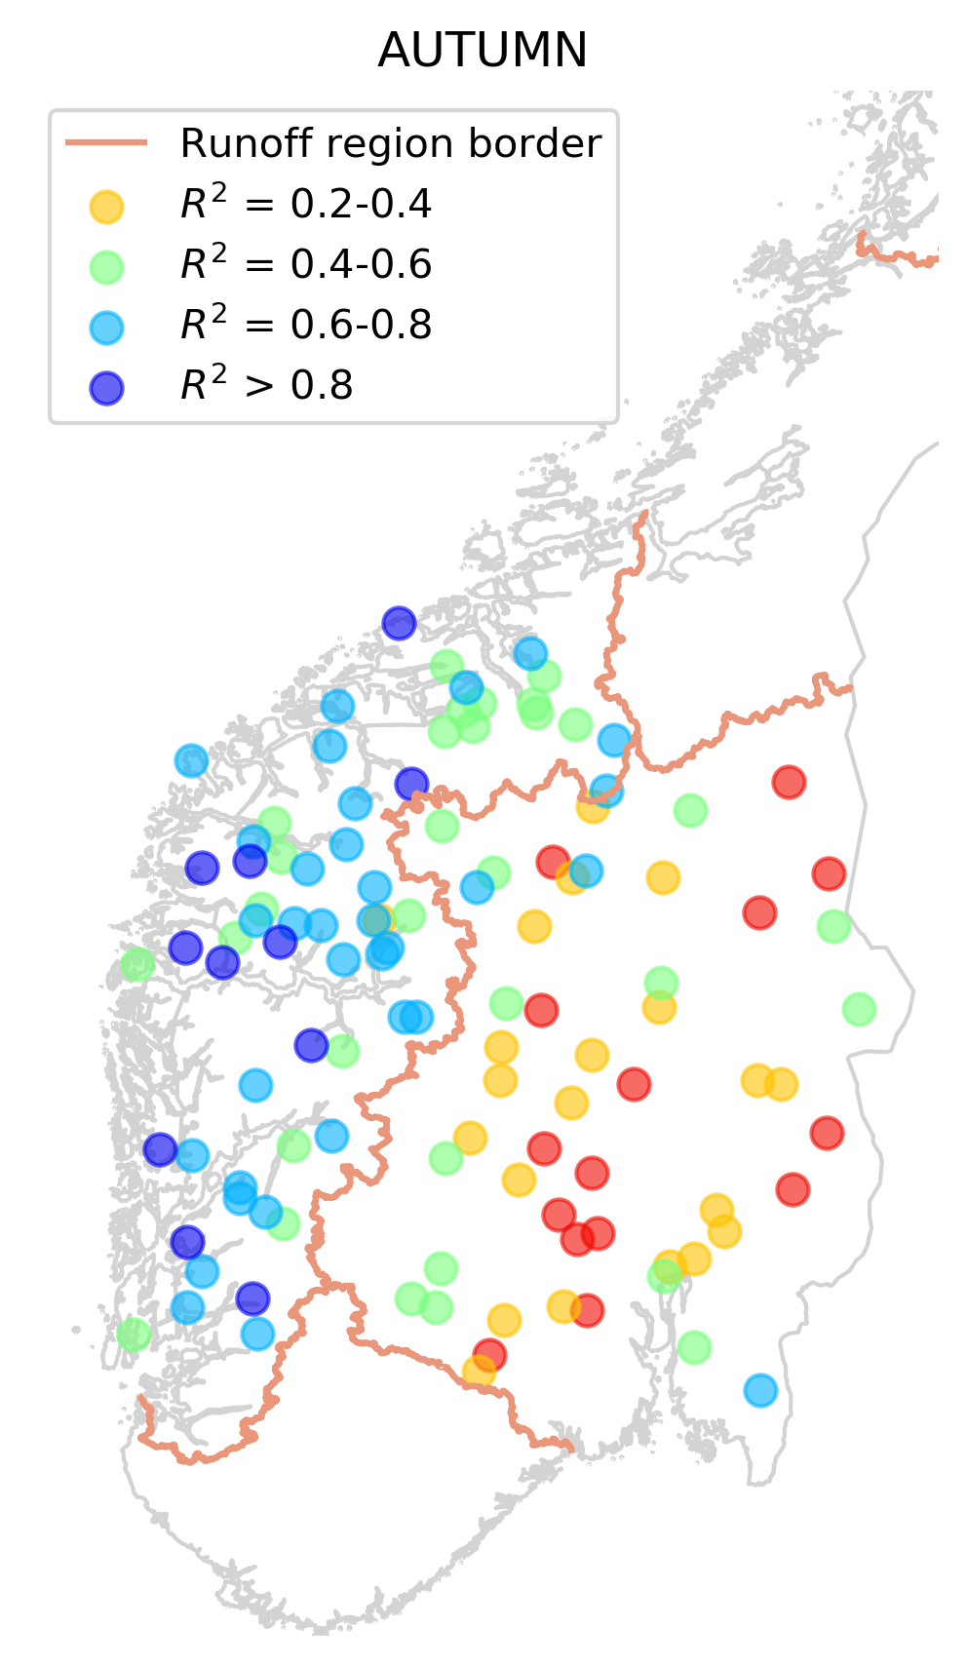
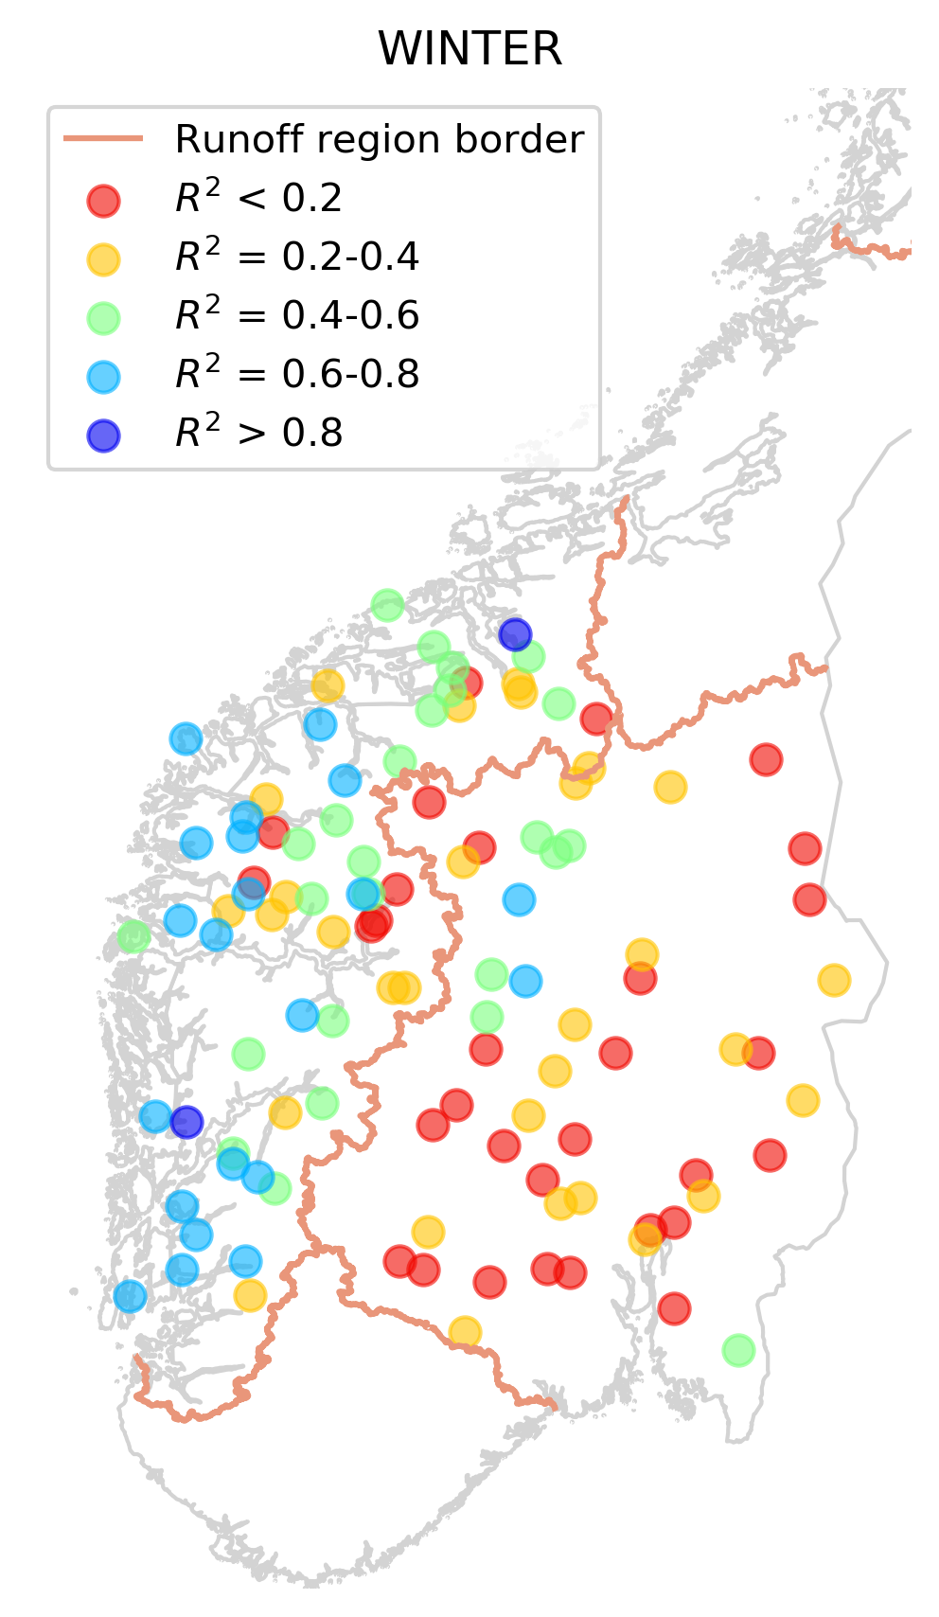
Multiple regression by season
Qtrend ~ SMtrend + RFtrend + Ttrend

Slide 11
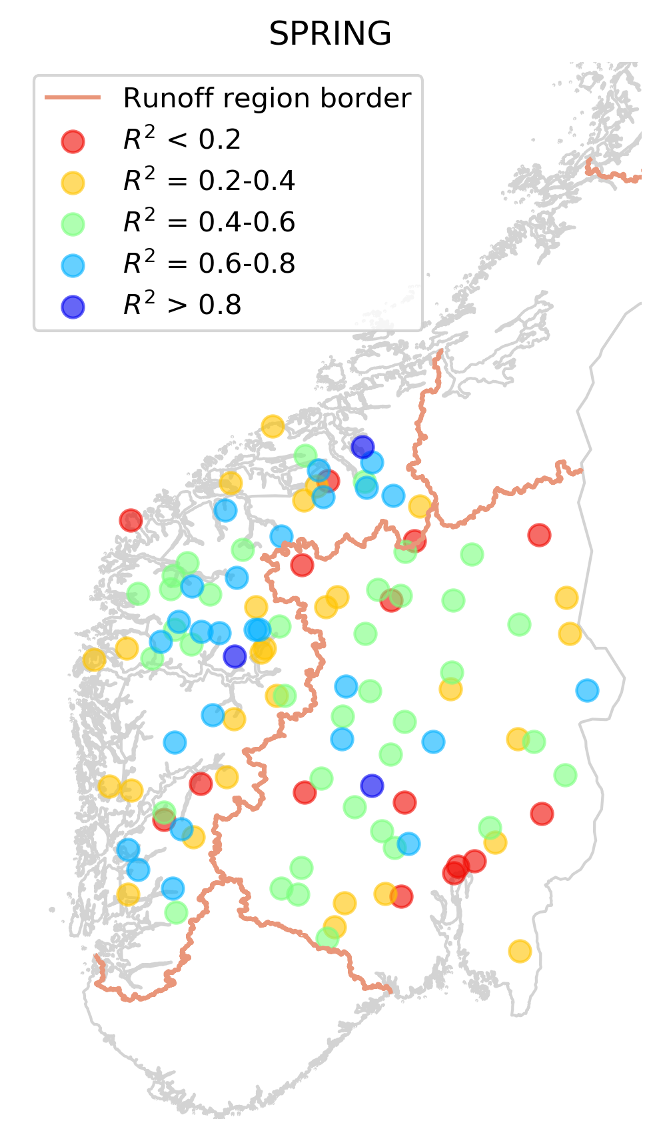
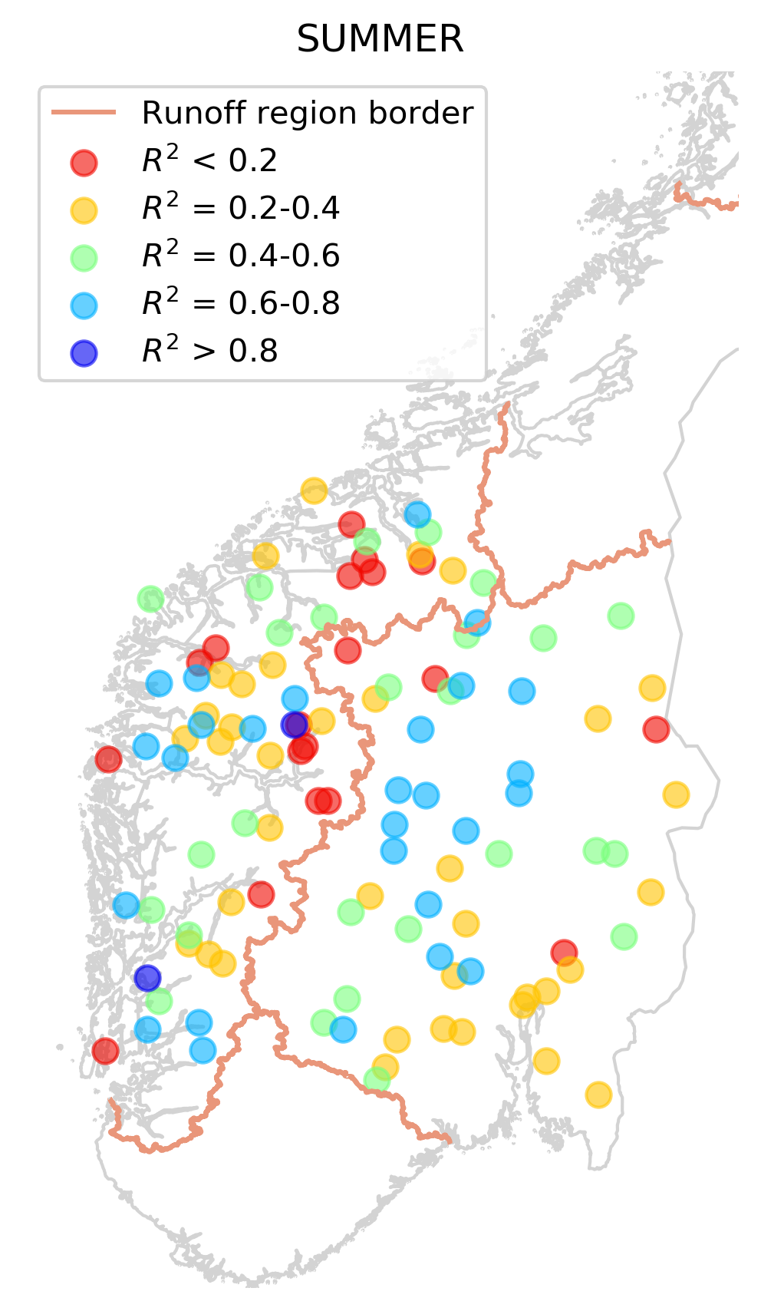
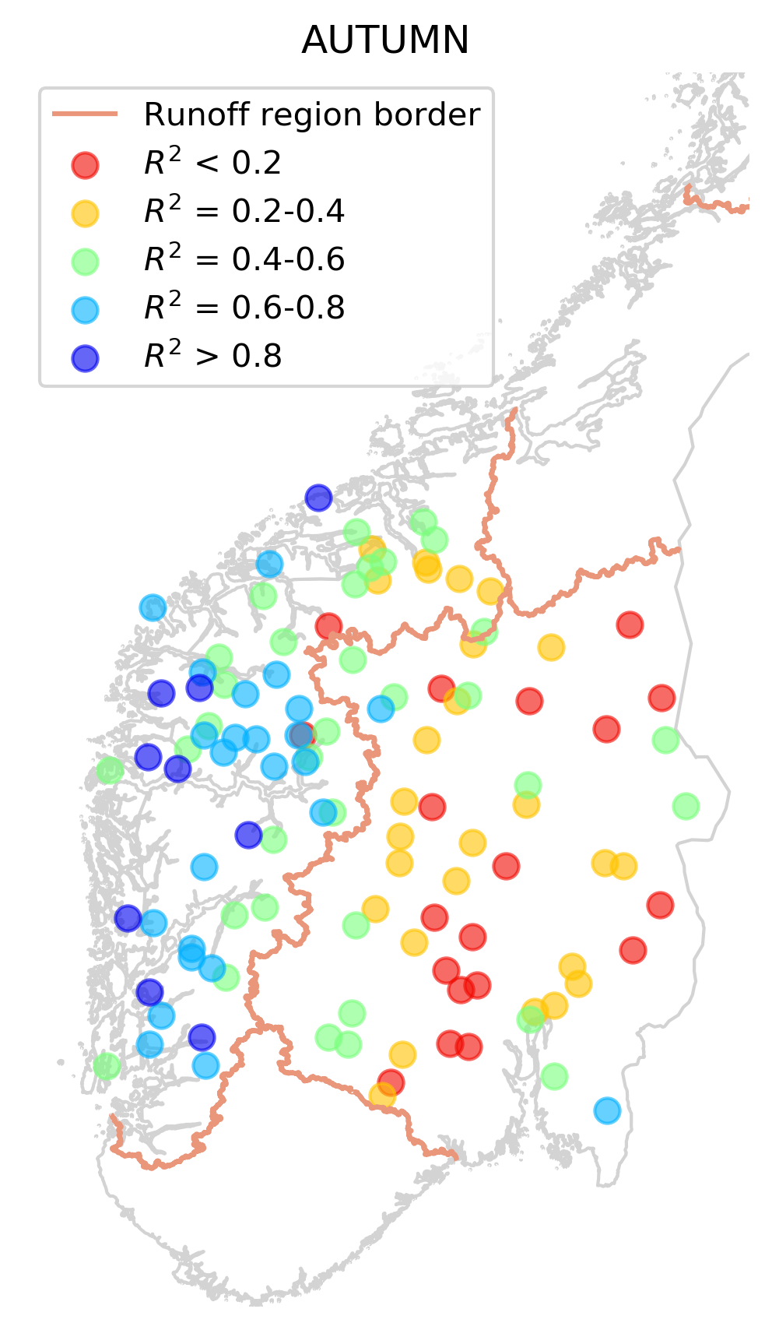
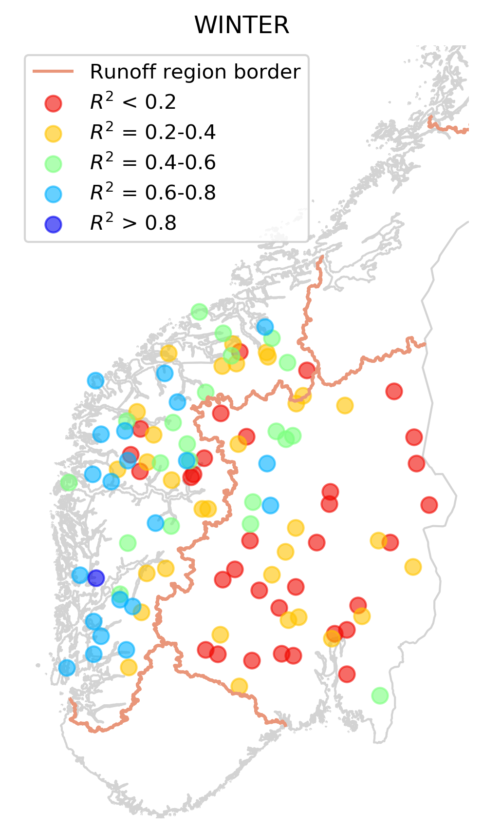
Multiple regression by season
Qtrend ~ RFtrend + Ttrend

Slide 12
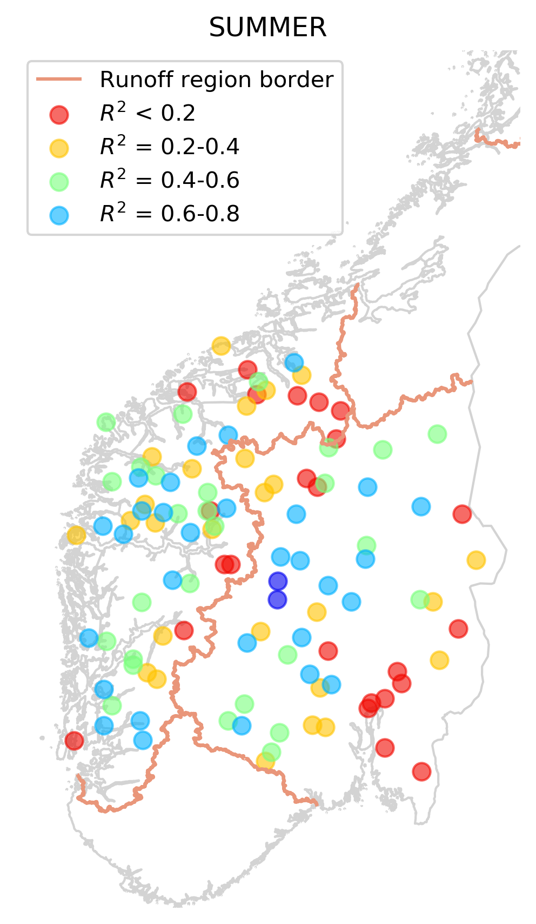
Multiple regression by season
Qtrend ~ SMtrend + RFtrend
Qtrend ~ SMtrend + RFtrend + Ttrend
Qtrend ~ RFtrend + Ttrend

Slide 13
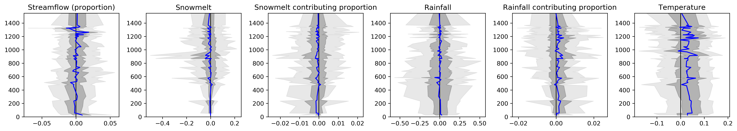
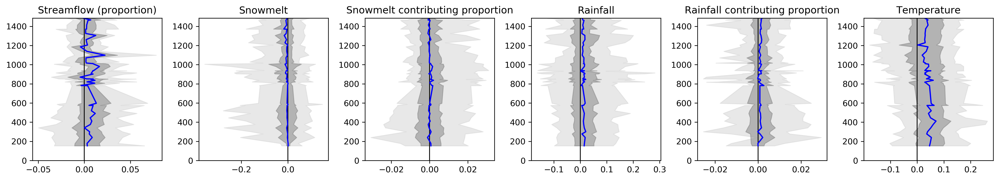
Altitude dependence
Vestlandet
Østlandet

